Slide 1
Harriet Beecher Stowe presents….
Uncle Tom’s Cabin

Slide 2
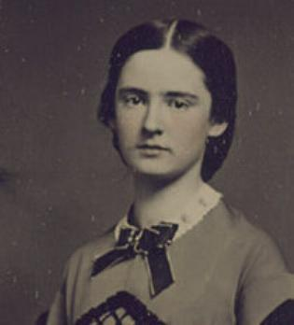
BIOGRAPHY
Early life :
Harriet Elisabeth Beecher was born June 14, 1811 in Litchfield, Connecticut. Born as the seventh child of Roxana and Lyman Beecher.
In 1832, the Beecher family moved to Cincinnati, Ohio.
By 1836, Beecher married Calvin Stowe. She Kept her maiden name and added Stowe as a last name. Ironically enough, they had seven children.
Career:
Beecher began her writing experiences in the parlor. She wrote different stories for a Cincinnati literary club.
In 1834 Beecher began writing for the Western Monthly Magazine.
In 1849, she published her first volume, The Mayflower.
In 1850, Stowe wrote her most famous works, Uncle Tom’s Cabin. It became a best seller. It was the first novel that opened up the truths and reality of slavery to the entire world.
Death : On July 1, 1896, Stowe passed away. At the age of 85, Stowe’s body was at rest in cemetery at Phillips Academy in Andover, Massachusetts.

Slide 3
INSPIRATIONS
Personal Experiences
When Beecher married Calvin Stowe, a professor in the Lane Seminary, she had the opportunity to visit the south.
In 1850, Congress passed the Fugitive Slave Law. This law mandated the return of any runaway slaves. During this time, there were weekly antislavery journals. Stowe wrote to the editor, Gamaliel Bailey about the problems of slavery. In her letter she said, “I feel now that the time is come when even a woman or a child who can speak a word for freedom and humanity is bound to speak... I hope every woman who can write will not be silent.“

Slide 4
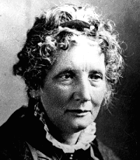
INSPIRATIONS
Christianity
“I looks like gwine to heaven,” said the woman; “an’t thar where white folks is gwine? S’pose they’d have me thar? I’d rather go to torment, and get away from Mas’r and Missis.”

Slide 5
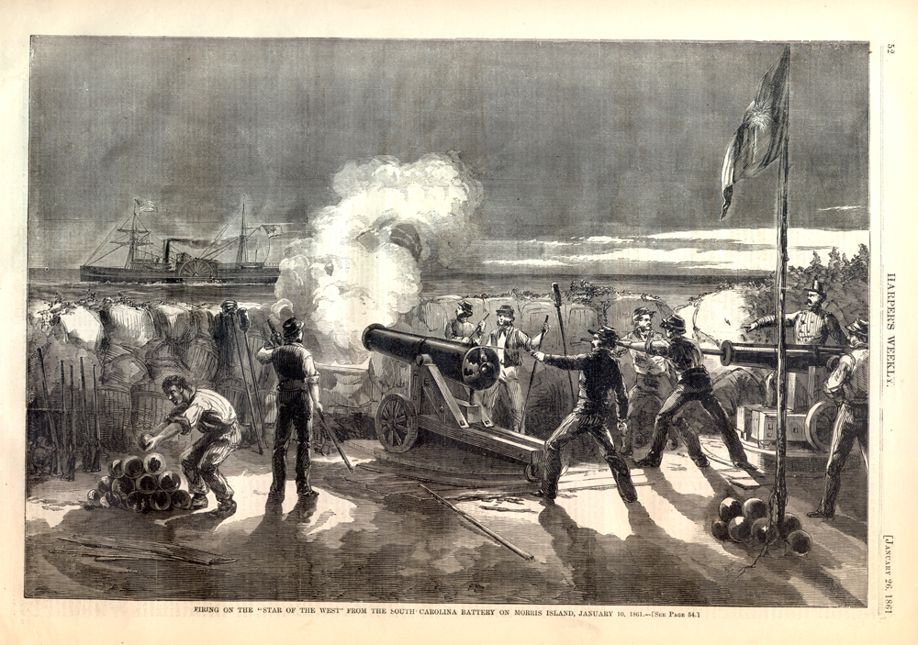

Slide 6
Stylistic and Innovative Qualities
Usages of similes and metaphors:
Realism:
"Eliza made her desperate retrest across the river just in the dusk of twilight. The gray mist of evening, rising slowly from the river, enveloped her as she disappeared up the bank, and the swollen current and floundering masses of ice presented a hopeless barrier between her and her pursuer."
“‘Hulloa, Jim Crow!’ said Mr. Shelby, whistling, and snaping a bunch of raisins towards him, ‘pick that up now!’ The child scampered, with all his little strength, after the prize, while his master laughed.”

Slide 7
Stylistic and Innovative Qualities
Usages of imagery and description
“There was something in his appearance remarkably beautiful and engaging. His black hair, fine as floss silk, hung in glossy curls about his round, dimpled face, while a pair of large dark eyes, full of fire and softness, looked out from beneath the rich, long lashes as he peered curiously into the apartment.”

Slide 8
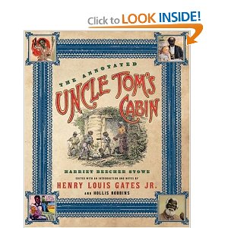
KEY ARTWORK(S)
Uncle Tom’s Cabin
Other works:
1853, A Key to Uncle Tom's Cabin
1856, Dred: A Tale of the Great Dismal Swamp
1869, Old Town Folks
1870, Lady Byron Vindicated
1873, Palmetto Leaves

